Slide 1
New Opportunities for BRIC+ Cooperation in the Arctic:
China's Perspectives
Dr. DENG Beixi
Head of Division of Polar Policy Studies, Polar Research Institute of China
Scientific and Business Conference POLAR 2025
May 21, 2025

Slide 2
I. BRIC+ Cooperation in the Arctic in new circumstances
The Arctic emerging as a global focal point due to its unique scientific value, strategic significance, abundant resources and potential for new shipping routes under climate change.
Russia, the only Arctic state within BRICS, playing a pivotal role of bridging BRICS countries.
BRICS Ocean and Polar Science and Technology Working Group Рабочая группа по сотрудничеству в океанической и полярной зонах исследований being established to promote bilateral and multilateral Arctic cooperation in areas such as joint cruise, flagship projects and collaborative research.
BRICS members have achieved progress in Arctic energy and resource development, utilization of Arctic shipping routes, environmental protection, and governance coordination.
Looking ahead, if BRICS countries can forge a community of shared interests in the Arctic while enhancing cohesion through multilateral mechanisms, BRICS could become a significant actor in Arctic governance.

Slide 3
I. BRIC+ Cooperation in the Arctic in new circumstances
Arctic cooperation has been partially paralyzed since February 2022, and there remains no clear plan regarding the resumption of Senior Arctic Officials meetings and ministerial-level meetings.
It is highly likely that the inefficiency of Arctic governance mechanisms will persist for a longer period.
Non-Arctic states face diminishing platform for participating in Arctic governance and international cooperation.
Russia, constrained by its deteriorating relations with the U.S. and Nordic countries, needs to enhance the engagement of non-Arctic states and adopt a more open stance toward Arctic cooperation.

Slide 4
II. Basis for BRIC+ Cooperation in the Arctic
Institutional arrangement established for cooperation in the polar region within BRIC platform (BRICS Ocean and Polar Science and Technology Working Group Рабочая группа по сотрудничеству в океанической и полярной зонах исследований)
Bilateral Arctic cooperation among BRIC countries has been conducted for many years.
An Example: China – Russia Arctic Cooperation:
  In 2023, China and Russia affirm that the bilateral comprehensive strategic partnership for the new era has reached an unprecedented level and continues to develop and that "the Arctic should remain a zone of peace, stability, and constructive cooperation.“
  In 2024, China and Russia highlighted the establishment of the Subcommittee on Arctic Shipping Подкомитет по арктическому судоходству? to promote the development of Arctic shipping routes as vital international transportation corridors.
  In 2025, China and Russia reaffirmed both parties' commitment to upholding peace and stability in the Arctic region and preventing the emergence of military-political tensions in the area.

Slide 5
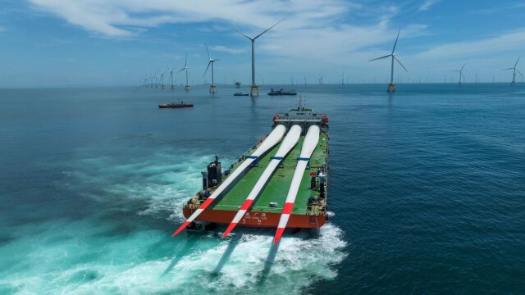

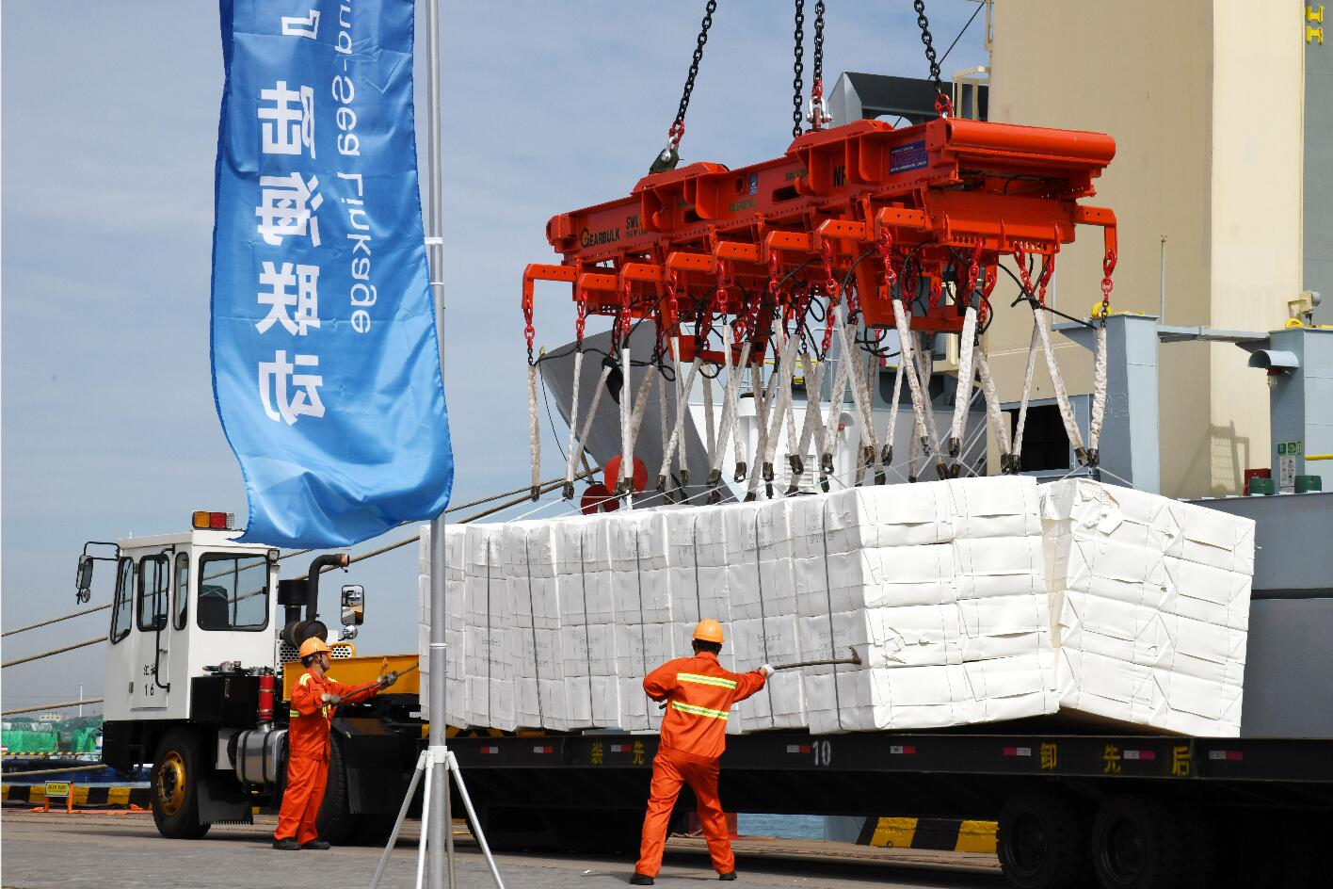
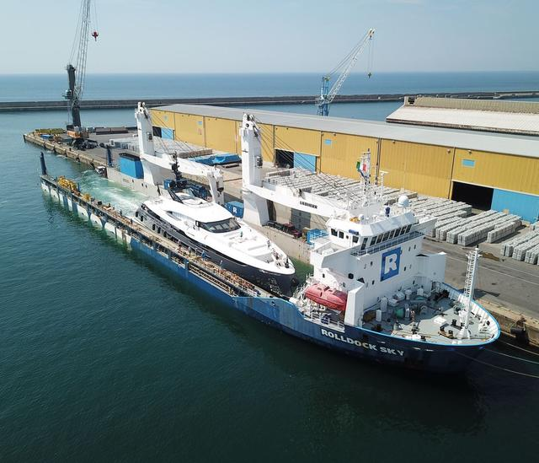
Table: China’s Utilization of Arctic Waterway 2013-2024
 | 2013 | 2015 | 2016 | 2017 | 2018 | 2019 | 2020 | 2021 | 2022 | 2023 | 2024 | Total
No. of Voyages | 1 | 2 | 6 | 5 | 8 | 9 | 11 | 14 | 0 | 8 | 13 | 77
State-owned COSCO Specialized Carrier started commercialized operation since 2013, and completed a total of 56 commercial voyages (of 53 transits) as of the end of 2021.
Private New New Shipping Line opened Arctic business starting from 2023, specializing in China-Russia maritime trade, and launched the "Arctic Express No. 1" sea-rail combined transport route with Rosatom.
Wind power equipment
Subway Shield Machine
Paper Pulp
Yacht

Slide 6
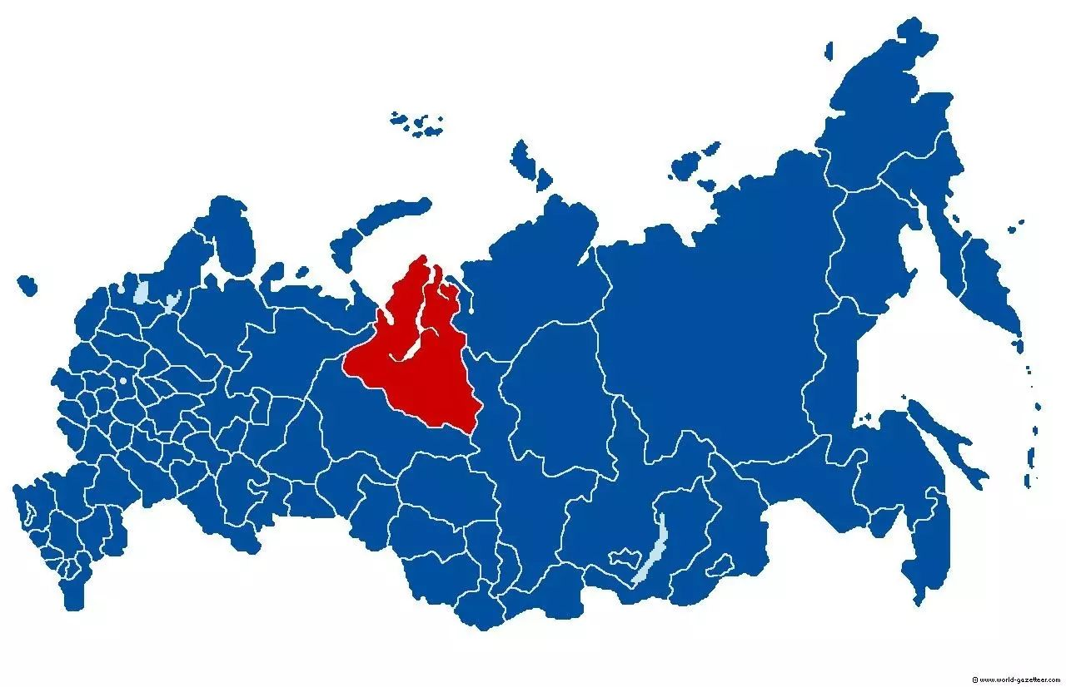
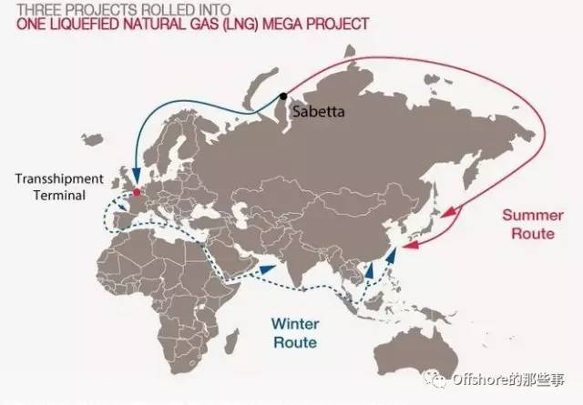
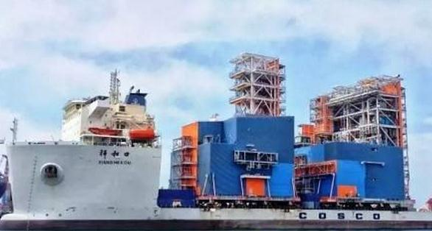
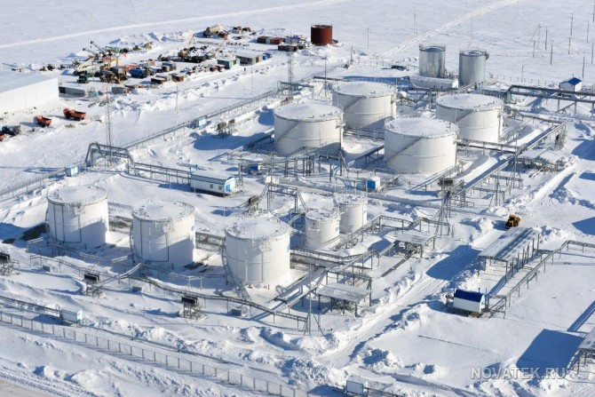
Russia's Yamal LNG Project – A Shipping-Driven Resource Development Initiative

Slide 7
Scientific cooperation:
  Establishment of joint laboratory, e.g. China-Russia Joint Laboratory on Polar Technology and Equipment
  Bilateral cooperation agreement between institutes – Polar Research Institute of China & Murmansk Marine Biological Institute Мурманский морской биологический институт in Sept. 2023 on the Eastern Economic Forum.
S&R cooperation:
  Memorandum of Understanding (MoU) to strengthen maritime law enforcement cooperation signed by coast guards

Slide 8
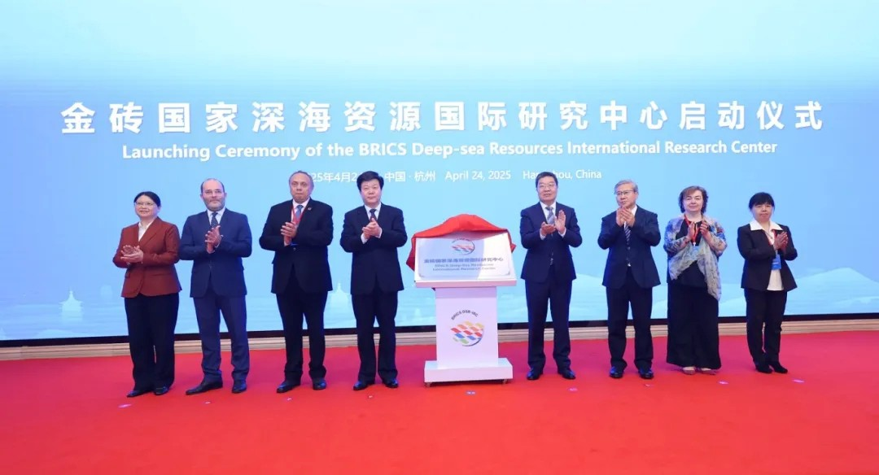
III. Prospect for BRIC+ Cooperation in the Arctic
China and Russia regarding the BRICS as a pivotal platform for addressing international affairs.
China and Russia pledging to facilitate the seamless integration of new members into BRICS cooperation mechanisms, continue advancing the global influence of BRICS, and strengthen ties between BRICS members and the broader Global South.
China implementing the outcomes of BRICS summits with the establishment of BRICS International Research Center for Deep-Sea Resources in April 2025.

Slide 9

III. Prospect for BRIC+ Cooperation in the Arctic
Taking advantage of BRIC Ocean and Polar Science and Technology Working Group on both multi-lateral and bi-lateral basis within the BRICS Science, Technology, and Innovations framework.
Cooperative research projects, cooperative flagship projects, joint capacity building strategies and joint Roadmap
E.g. an international scientific station in Svalbard, the "Snowflake" International Arctic Station in Yamal-Nenets region, the “North Pole” Floating Arctic Research Vessel ледостойкая самодвижущаяся платформа (ЛСП) «Северный полюс» .
Joint project in regional and international agendas, e.g. IPY 2032-2033, and the UN Decade of Ocean Sciences for Sustainable Development Десятилетие науки об океане в интересах устойчивого развития.

Slide 10
Thank you for your attention!

